Slide 1

Polynomial regression & Response surface analysis tutorial
TCaT Lab

Slide 2
What is polynomial regression?
Linear regression: y = ax + b
Non-linear relationship
y = a1x^2 + a2x + b (second-order polynomial regression)
y = a1x^3 + a2x^2 + a3x + b (third-order polynomial regression)
…..
Today we will only talk about the second-order polynomial regression relationship
Notes:
次方： to the power of n
2： square
3： cube
4： to the power of 4
…

Slide 3
What does it mean in io research?
To measure the similarity or difference, congruence or incongruence, fit or misfit between two variables and how that relates to the dependent variables
Z = (x - y)^2
Outcome = (IV1 - IV2)^2
Notes:
For example:
How does the similarity in agreeableness between a person and their partner influence the quality of their relationship? [relationship = (agreeableness1 - agreeableness2)^2]
The smaller the (agreeableness1 - agreeableness2), the higher the similarity; and the bigger the value is, the higher the dissimilarity

Slide 4
Example: age difference & personality fit – perceived relationship happiness
OLD
YOUNG
Research questions we can answer:
What predicts perceived happiness in relationships? Extroversion similarity or differences?
If similarity – will it be better if they are both extroverted or both introverted?
If differences – will it be better if the older person is more extroverted, or the younger person is more extroverted?

Slide 5
Two ways of approaching this
Difference score
Polynomial regression
Difference Z = x - y
Model.ds = y ~ b1 * Z + error
Difference Z = (x-y)^2 = x^2 – xy + y^2
Model.poly = Z ~ b1*x + b2*y + b3*x^2 + b4*xy + b5*y^2 + error

Slide 6
Z = b1 * X + b2 * Y + b3 * X^2 + b4 * XY + b5 * Y^2 + error
Person-organization fit and job satisfaction
Z = job satisfaction, X = Organizational Culture Values, Y = Employee Personal Values
Leader-member exchange quality and employee turnover
Z = Employee Turnover Intentions, X = Leader’s Expectations, Y = Member’s performance
Skill-job match and employee performance
Z = Employee Performance, Z = Job Skill Requirements, Y = Employee Skill Level

Slide 7
You get 5 coefficients, How to make sense of them? Response surface analysis
What is response surface analysis?
In simple language – eliminate one dimension for better reading OR turn a 3D figure into 2D for better interpretation
“CUT” it into two 2D figures to read the relationship
When they are the same: X = Y
When they are the opposite: X = -Y
Notes:
Academic definition: an approach that allows examining the extent to which combinations of two predictive variables relate to one outcome variable

Slide 8
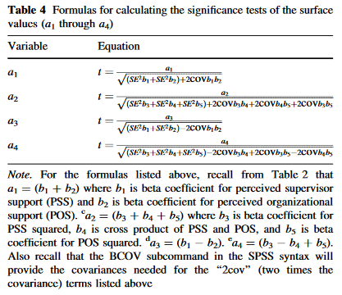
Supplement

